Slide 1
MAY 2026
Clare County
WELCOME LETTER HEADLINE
Dear Clare County 4-H community,
As we head into May and the school year begins to wind down, it’s time to check in on your 4-H projects! If you haven’t started your larger projects yet, now is the time to jump in and get them underway
A few reminders about things coming up at the fair:
Flowerpot Contest entries should be planned and planted soon.
Poster Contests ideas can be started anytime
Start your Record Books and keep them updated along the way.
Getting started now will help avoid the last-minute rush and set you up for a successful summer. We’re looking forward to seeing all the hard work and creativity from our Clare County 4-H youth.
This summer we would like all 4-H families to display a sign promoting 4-H. If you need a sign, please contact the MSU Extension office.
Renee Sanders
Clare County 4-H Program Coordinator
Renee Sanders
Clare County 4-H Coordinator
MSU Extension
Clare County
225 W. Main Street
Harrison, Michigan
48625
989-539-7805
biselr@msu.edu
YQCA forms | May 1, 2026 | 5 pm | Clare County Fairgrounds
Flower Sales Pick Up | May 15-16, 2026 | TIME TBD | Clare County Fairgrounds
4-H Council Meeting | May 27, 2026 | 6 pm | PMDL, Clare Michigan
Fair Forms | July 1, 2026 | Clare County Fairgrounds
Cloverbud Day Camp | July 7-8, 2026 | TBD | Coldwater Lake 4-H Camp
4-H Overnight Camp | July 15-16, 2026 | TBD | Coldwater Lake 4-H Camp
Home Arts Judging | July 31, 2026 | 4:30-7 pm | Clare County Fairgrounds
Home Arts Auction | August 1, 2026 | Clare County Fairgrounds
Clare County Fair | August 3-8, 2026 | Clare County Fairgrounds
https://www.canr.msu.edu/county/
This is the link to find your record books https://www.clarecountyfair.org/record-keeping.html
Fair questions? Call 989-539-9011 or email clarefair9011@gmail.com

Slide 2

Creating Beyond-Ready Youth Through 4-H Project Learning
May 4: Michigan 4-H Volunteer Webinar Series – Supporting Youth Entrepreneurs and Your Role in 4-H Animal Projects
Online
Learn how to support youth in making smart decisions that lead to financial and personal growth using activities from MSU Extension’s Youth Business Guide to Success. Discover how you can mentor youth in goal setting, budgeting, marketing and record-keeping for real-world skills.
www.canr.msu.edu/events/michigan-4-h-volunteer-webinar-supporting-youth-entrepreneurs-your-role-in-4-h-animal-projects
May 5: Make the Most of Your Market Animal Project Webinar – Market Mastery
Online
Delve into the five Ps of marketing and explore strategies to elevate your outreach. Learn practical tools and techniques to promote projects successfully, enhance sales and build valuable industry connections.
www.canr.msu.edu/events/market-animal-project-webinar-5-5
May 12: Make the Most of Your Market Animal Project Webinar – Records to Riches
Online
Learn to keep track of what you spend and earn to make smart choices for market livestock projects. Equip youth with tools to track expenses, set goals and ensure projects are profitable and rewarding.
www.canr.msu.edu/events/market-animal-project-webinar5-12
May 14: Online Parent Talk System Webinar Series
Online
A course for caregivers of toddlers to teens to improve communication and provide strategies for raising confident, caring, responsible children. Offered each Thursday from May 14 – June 18.
www.canr.msu.edu/events/the-parent-talk-system-series-may-june-2026
May 18: Adulting 101 Webinar – Cooking with Confidence
Online
Increase your confidence in the kitchen. From reading recipes to mastering kitchen terms, explore simple ways to get creative with ingredients and make tasty meals without stress or waste.
www.canr.msu.edu/events/cooking_with_confidence
May 19: Make the Most of Your Market Animal Project – Pitch to Payment
Online
Communication and outreach are important methods to recruit buyers for market livestock projects. Discover how to use social media to promote your project, reach a wider audience and share progress.
www.canr.msu.edu/events/market-animal-project-webinar5-19
June 6: Garden Geocache Event
Michigan 4-H Children’s Gardens, East Lansing
Cache veterans and new enthusiasts are welcome at this geocaching adventure. Bring your picnic lunch and enjoy a day of caching in the gardens.
www.canr.msu.edu/events/garden-geocache
4-H prepares youth for the world of work by engaging them in high quality, hands-on learning grounded in meaningful project content. When young people apply skills, solve real problems and reflect on their learning, they build confidence and readiness for future careers.
4-H programs intentionally create these opportunities, helping youth practice communication, teamwork,
decision making and technical skills that transfer to real world settings. Some ways to deepen project work could include: adding real life tasks, inviting youth to demonstrate mastery or guiding reflection that connects the activity to future workplace expectations. Every project meeting is a chance to help youth become Beyond Ready, capable, and confident.
#BeyondReady

Slide 3

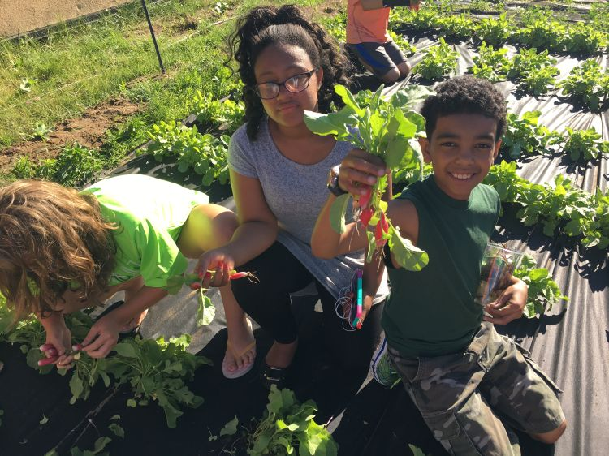
Michigan 4-H license plate celebrates first anniversary!
Last April, the Michigan 4-H community celebrated a milestone decades in the making: the launch of the Michigan 4-H license plate. One year later, Michigan 4-H continues to celebrate the plate’s existence and the potential it holds for the program. Available through the Michigan Secretary of State, a portion of each 4-H license plate sold and renewed benefits Michigan 4-H Youth Development.
“The Michigan 4-H license plate has been a dream of our 4-H professionals and families for several decades,” explained Quentin Tyler, director of MSU Extension. “So, when the plate was launched one year ago, it was a wish come true. But more than being a vision brought to life, the plate is an incredible asset – raising visibility of the 4-H clover while generating additional dollars to support our 4-H program and its emerging needs.”
Like other special cause fundraising license plates in the state, the Michigan 4-H license plate costs $35, with $25 of the purchase fee benefiting Michigan 4-H Youth Development. A $10 fee is also be charged to benefit Michigan 4-H when the plate is renewed. License plates may be ordered by visiting Michigan.gov/sos, by mailing in a form or scheduling a visit to any Secretary of State office. The plate will be delivered by mail in two to three weeks. Supporters do not need to wait until their plate renewal period to order the 4-H plate.
To learn more, visit extension.msu.edu/4-HPlate.
Michigan 4-H Foundation opens 2026-27 grant cycle
The Michigan 4-H Foundation has announced grant opportunities of up to $2,000 to support local 4-H clubs and county programs for the 2026-2027 program year. 4-H volunteer leaders, members and staff are encouraged to apply for these competitive funds. All grant applications are due June 1, 2026.
“Local 4‑H programs are at the heart of our 4-H programs,” says Abbey Miller, director of the Michigan 4-H Foundation. “These mini‑grants help 4-H youth, volunteers and staff create hands‑on learning experiences that spark curiosity, build confidence and strengthen communities. We’re grateful to support the innovative work happening across Michigan.”
Opportunities include:
Michigan 4-H Legacy Grants of $1,000. These grants are awarded to support development of a new program or initiative or to strengthen, enhance or expand a current program that is making a difference.
4-H On-Target Grants of $500. These grants support 4-H shooting sports programs to enhance existing programs, develop a new program or offer a special experience related to 4-H shooting sports.
The Collins 4-H Youth Horticulture Grant of $600. This grant is available only to 4-H youth clubs and supports advancement of club work in plant science and horticulture activities.
4-H Educational Garden Grants of $1,000. These grants support the creation of local 4-H educational gardens in Michigan.
The M. Louise Palczewski Therapeutic Horseback Riding Grant of $2,000. This grant opportunity is to support the creation and/or operation of new or existing 4-H Proud Equestrian Programs (PEP) located in Michigan.
Learn more or apply online at http://mi4hfdtn.org/grants. Questions? Contact the Michigan 4-H Foundation at 517-353-6692.

Slide 4
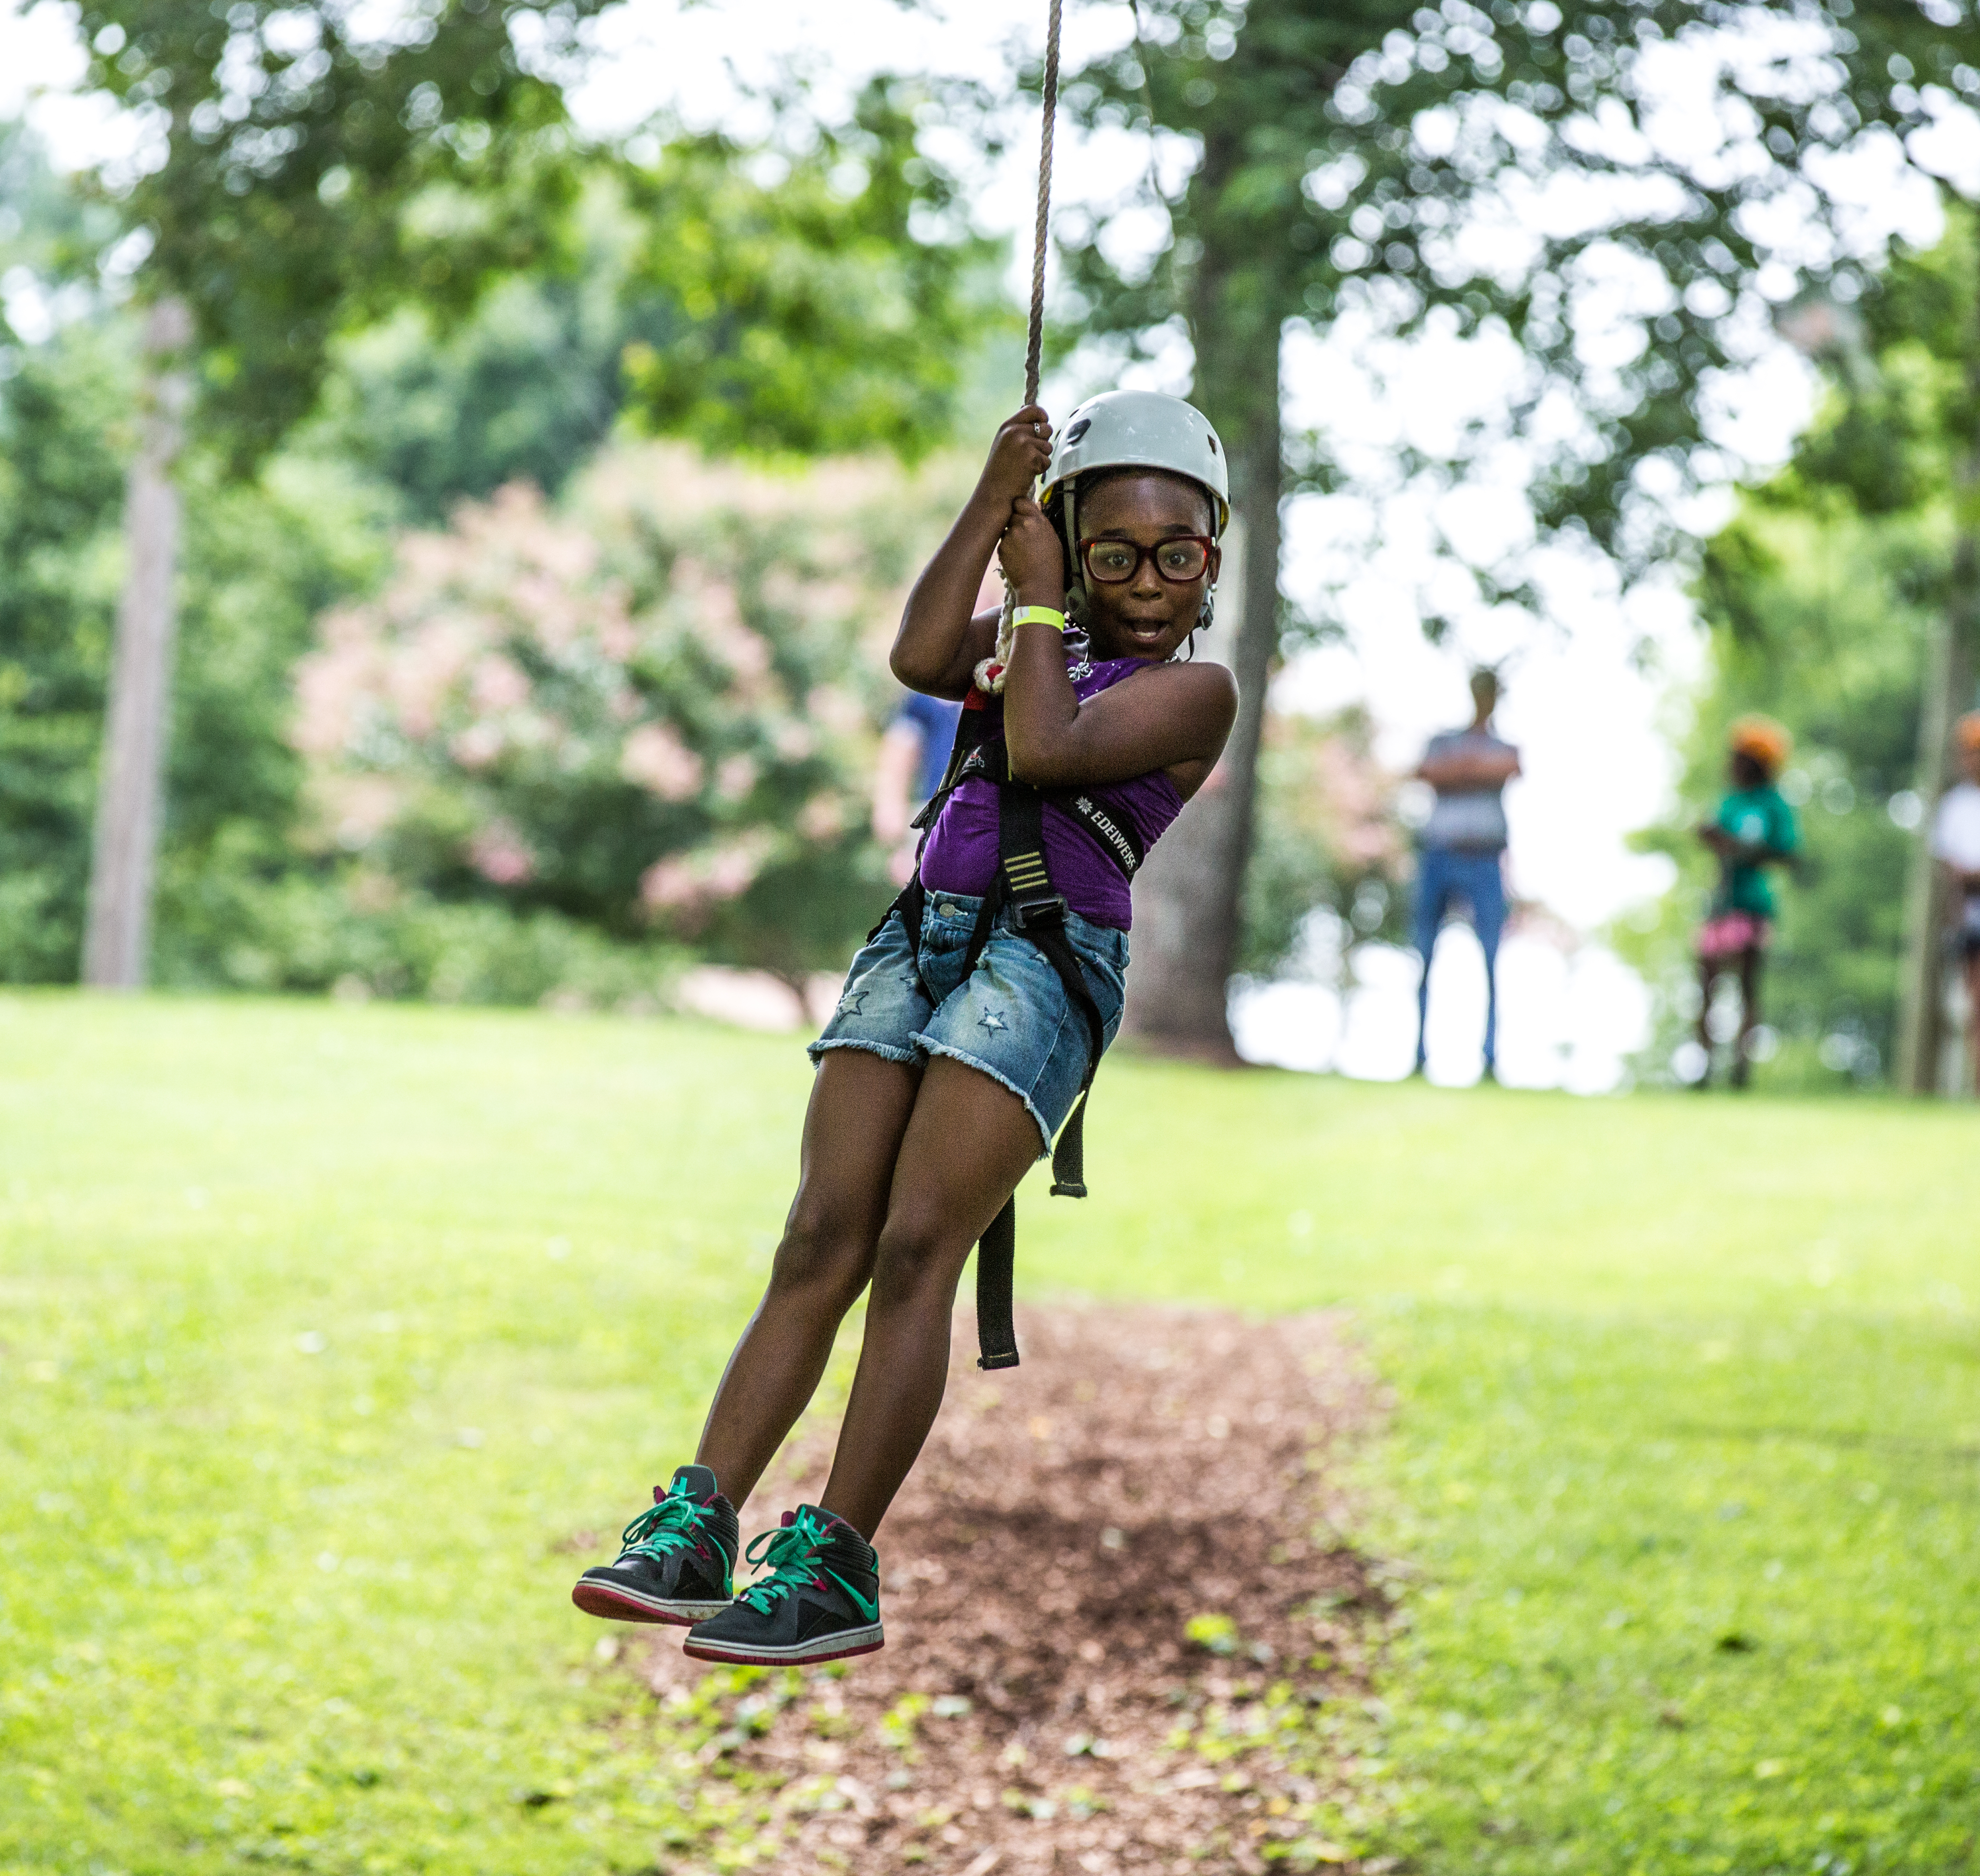
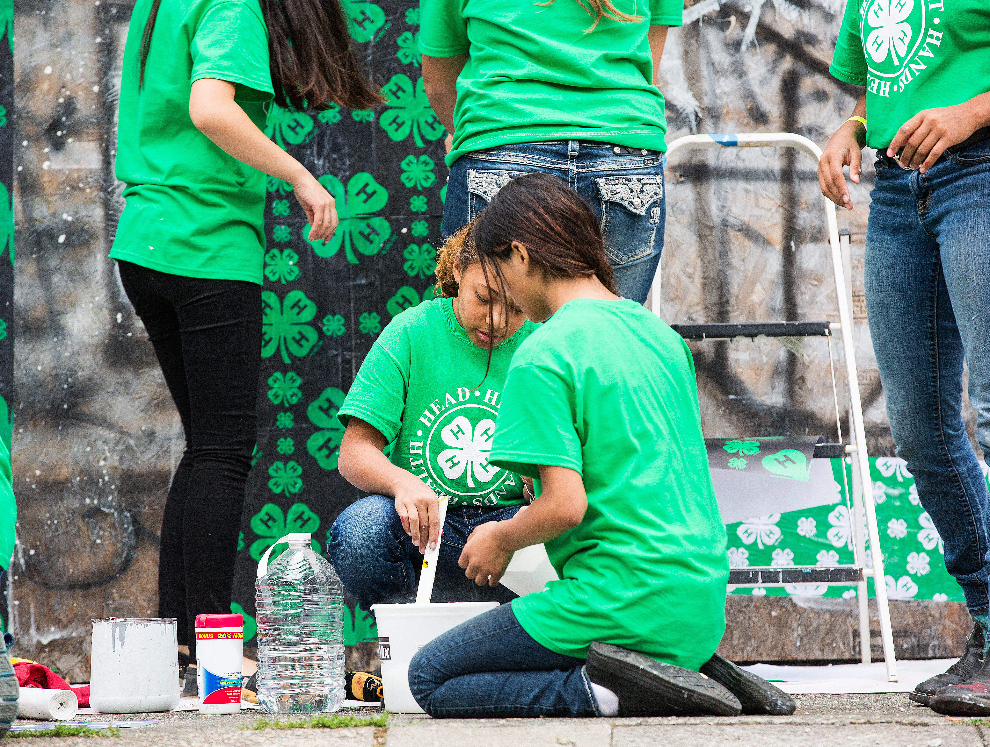
Camp Councilors Needed - Teens and Adults
Camp counselors play an important role in creating a fun, safe, and positive camp experience for our youth. This opportunity is great for teens and adults who enjoy working with young people, being part of a team, and helping make camp a memorable experience for everyone involved.
Counselors gain leadership experience, build communication skills, and make lasting connections while supporting a meaningful 4‑H program.
If you or someone you know may be interested, please contact the Clare County 4‑H office for more information and application details. Help us spread the word as we build our camp team!
Teen Judges needed for Cloverbud show.
Being a Teen Judge is an easy way to earn leadership experience while helping our youngest members have a fun, positive show experience. Teen judges encourage Cloverbuds and help guide them through the process.
If you’re interested in being involved and giving back to 4-H, contact the Clare County 4-H office for more information.
Contests at the Clare County Fair
Flowerpot Contest at the Fair.
Open to all youth and adults with a connection to the Clare County 4-H. Entries will be submitted to the MSU Extension Building Monday August 3 by 5 pm. Flowerpot needs to be displayed for the duration of the Fair; your ribbons will be attached to the flowerpots after judging takes place. You must pick up your flowerpot on Saturday August 8.

Slide 5
Mailing Panel
Clare County MSU Extension
215 W Main Street
Harrison, MI 48625

